Slide 1
Multimedia
(Audio, Video, Animation)

Slide 2
Audio and Video
Android supports playback of most popular audio and video formats.
Recordings are stored in files, and can optionally be put in a persistent media store (MediaStore).
Android devices currently on the market support the following audio and video formats.
Audio
AAC LC/LTP *
HE-AACv1 (AAC+)
HE-AACv2 (enhanced AAC+)
AMR-NB *
AMR-WB *
MP3
MIDI
Ogg Vorbis
PCM/WAVE
Video
H.263 *
H.264 AVC
MPEG-4 SP

Slide 3
Playing Audio and Video(1)
MediaPlayer class used as standard to play audio and video.
A MediaPlayer goes through several states during its life cycle:
Idle
The MediaPlayer is instantiated.
Initialized
The media source is set.
Preparing
The MediaPlayer is preparing the media source for playback.
Prepared
The MediaPlayer is prepared for playback.

Slide 4
Playing Audio and Video (2)
Started
Playback is in progress.
Paused
Playback has been paused.
Payback complete
Playback of source is done (the playback can be started again).
Stopped
The MediaPlayer is no longer prepared to play the source.
End
The MediaPlayer is no more, and all associated resources are released.

Slide 5
Step with MediaPlayer
Create a MediaPlayer instance through the create() method (idle state).
Initialize the MediaPlayer with the media source to play (initialized state).
Prepare the MediaPlayer for playback through the prepare() method (preparing and prepared states).
Play the MediaPlayer through the start() method (started state).
During playback, if desired, you can pause, stop, or replay the MediaPlayer (started, paused, playback complete, and stopped states).
Once playback is finished, make sure to release the MediaPlayer’s associated resources by calling release() (end state).

Slide 6
Audio Playback(1)
Audio can be played through two methods, MediaPlayer and AudioTrack.
MediaPlayer is the standard, simple way to do playback. Its data must be in a file or be stream-based.
MediaPlayer audio playback
Determine whether a file placed within the application’s resources is to be used.
MediaPlayer mediaplayer = MediaPlayer.create(this, R.raw.example);
If you are not using an application resource, such as referencing an audio file residing on the filesystem (SD card and the like) or on a website (e.g., http://SomeServer/SomeAudioFile.mp3), you’ll have to manually set up and call your data source.
setDataSource(context, uri)
The context in the first argument is a means for the MediaPlayer to access the resources of the application itself, and thus be able to resolve the URI.

Slide 7
Audio Playback(2)
The alternative is to specify an absolute file path through:
setDataSource(path)
MediaPlayer mediaplayer = new MediaPlayer();
// Uri mediaReference = "http://someUriToaMediaFile.mp3";
// mediaplayer.setDataSource(this, mediaReference);
// use absolute path
mediaplayer.setDataSource("/sdcard/somefile.mp3");
// prepare mediaplayer
mediaplayer.prepare();
mediaplayer.start();

Slide 8
Audio Playback(3)
During play, the player can be paused or stopped. When in the paused state, it may be unpaused simply by calling start() again.
Once the MediaPlayer is stopped, you can’t start it again without resetting it through the reset() method, reinitializing it with the data source as shown earlier, and issuing prepare().
mediaplayer.pause(); // pausing
mediaplayer.start(); // going from pause to play
mediaplayer.stop(); // stopping
...
// to be able to play again reset must be called
mediaplayer.reset();
// now the media player must be reinitialized to play again

Slide 9
Audio Playback(4)
While the MediaPlayer is playing, you can track its current position in the file through getCurrentPosition(). This returns the amount of time played through in the file, in millisecond units:
mediaplayer.getCurrentPosition();
Once the MediaPlayer is no longer needed, make sure to release it so that the resources are cleaned up and made available for the system:
mediaplayer.release();

Slide 10
AudioTrack Audio Playback(1)
AudioTrack provides a much more direct method of playing audio. The following example shows the parameters required to set up an AudioTrack:
File mediafile = new File(mediaFilePath);
short[] audio = new short[(int) (mediafile.length()/2)];
// read in file and fill up audio[]
AudioTrack audiotrack = new AudioTrack(
// stream type
AudioManager.STREAM_MUSIC, 11025, AudioFormat.CHANNEL_CONFIGURATION_MONO,
// frequency, channel config—mono, stereo, etc. , audio encoding
AudioFormat.ENCODING_PCM_16BIT, audio.length, AudioTrack.MODE_STREAM);
// length, mode
The AudioTrack method provides the type of audio stream (music, ringtone, alarm, voice call, etc.), the sample rate in Hertz (44100, 22050, 11025), the audio configuration (mono or stereo), the audio format/encoding, the length of the audio in number of bytes, and the mode (static or stream).

Slide 11
AudioTrack Audio Playback(2)
Android’s AudioTrack, once configured, will automatically know how to interface with the hardware on the device.
To play the audio, issue the play() method and write the data out to the hardware:
audiotrack.play(); // start playing state
audiotrack.write(audio, 0, audio.length); // write audio to hardware
To pause the track, utilize the pause() method:
audiotrack.pause(); //pause
To stop playing the track, set it to the stopped state. If you don’t need the track anymore, release it. Otherwise, to replay the audio, you must reinitialize it:
audiotrack.stop(); // stop
audiotrack.release(); // release all resources

Slide 12
Video Playback
Can only use MediaPlayer.
Must additionally specify a view (called a surface) on which the video can be displayed.
Android offers a convenient control that includes its own surface: the VideoView view.

Slide 13
Video Playback
// create the view (in this case it is already included in the layout resource)
VideoView videoview = (VideoView) findViewById(R.id.videoview);
videoview.setKeepScreenOn(true);
// used if streaming
if (videouri != null) videoview.setVideoURI(videouri);
// absolute path if it is a file
else videoview.setVideoPath(videopath);
// let's add a media control so we can control the playback
mediacontroller = new MediaController(this);
mediacontroller.setAnchorView(videoview);
videoview.setMediaController(mediacontroller);
if (videoview.canSeekForward())
videoview.seekTo(videoview.getDuration()/2);
// start the playback
Videoview.start();

Slide 14
Animation
Animations are especially useful when the screen changes state, such as when content loads or new actions become available.
You should use the animation effect carefully, else cause delay.
Android support several types of animations, in this lecture we will discuss about zooming, fading and rotating.

Slide 15
Tween Animation
One of the ways to create animation is through the tween animation.
Animation class used to support the animation effect.
Tween animation can apply on any type of object.
Static function called loadAnimation() from class AnimationUtils use in animation.
Animation animation = AnimationUtils.loadAnimation(getApplicationContext(), R.anim.myanimation);
R.anim.animation is the name of animation xml file. It should be keep in /res/anim folder.
R.anim.animation shall indicating the types of animation to be perform.

Slide 16
Tween Animation
Functions in animation class:
  start()
  This method starts the animation.
  setDuration()
  This method sets the duration of an animation.
  getDuration()
  This method gets the duration which is set by above method
  end()
  This method ends the animation.
  cancel()
This method cancels the animation.

Slide 17
Tween Animation
We can call the startAnimation() method to apply the animation to object.
ImageView image1 = (ImageView)findViewById(R.id.imageView1); image.startAnimation(animation);

Slide 18
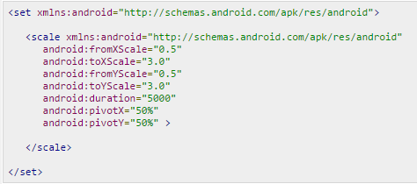
Zooming
In order to create the Zooming effect, you should create an xml file under the /res/anim.
fromXScale and fromYScale
Starting point of the object
toXScale and toYScale
End point of the object
Duration
Time of the animation
pivotX and pivotY
The center from where the animation should start

Slide 19
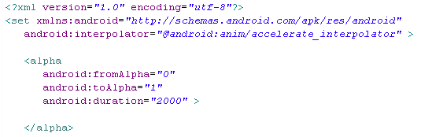
Fading
In order to create the Fading effect, you should create an xml file under the /res/anim.
android:fromAlpha
Starting opacity offset, where 0.0 is transparent and 1.0 is opaque.
android:toAlpha
Ending opacity offset, where 0.0 is transparent and 1.0 is opaque.

Slide 20
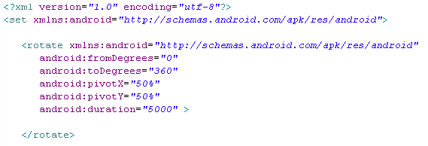
Rotating
In order to create the Rotating effect, you should create an xml file under the /res/anim.
android:fromDegrees
Starting angular position, in degrees.
android:toDegrees
Ending angular position, in degrees.
android:pivotX and android:pivotY
The X and Y coordinate of the center of rotation.

Slide 21
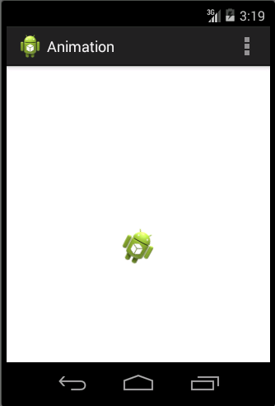
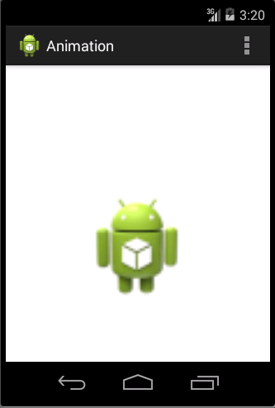
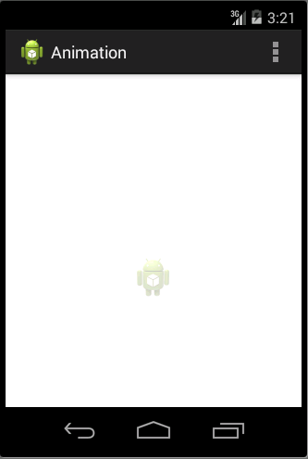
Example - Animation

Slide 22
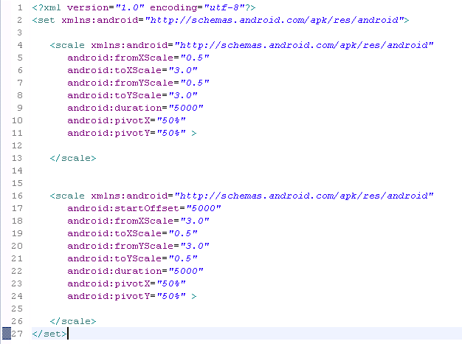
Zooming.xml

Slide 23
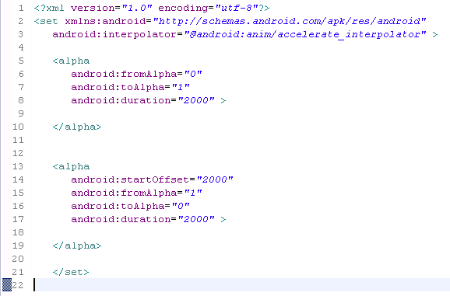
Fade.xml

Slide 24
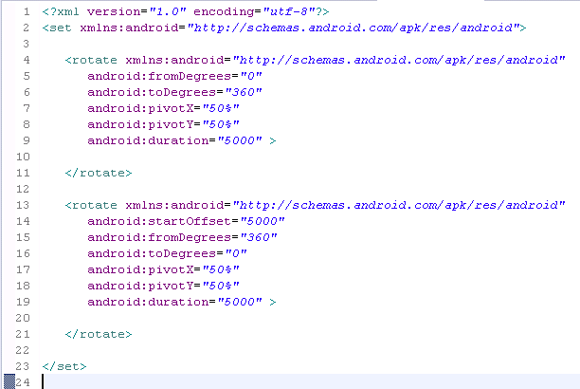
clockwise.xml

Slide 25
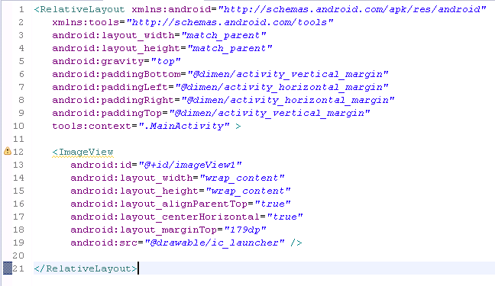
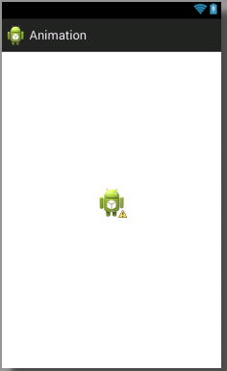
Activity_main.xml

Slide 26
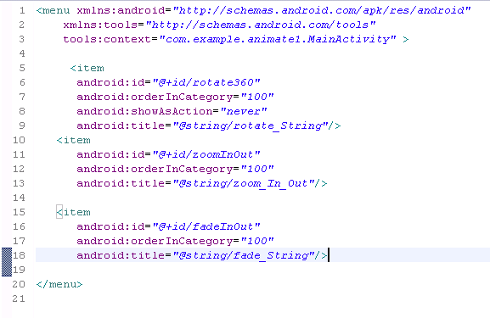
/res/menu/main.xml

Slide 27
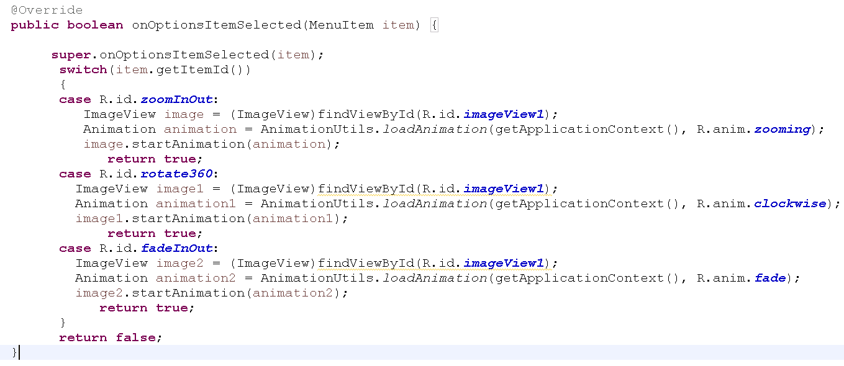
MainActivity.java

